Slide 1
Introduction to Bayesian Networks
A Tutorial for the 66th MORS Symposium
23 - 25 June 1998
Naval Postgraduate School
Monterey, California
Dennis M. Buede
Joseph A. Tatman
Terry A. Bresnick

Slide 2
Overview
Day 1
  Motivating Examples
  Basic Constructs and Operations
Day 2
  Propagation Algorithms
  Example Application
Day 3
  Learning
  Continuous Variables
  Software

Slide 3
Day One Outline
Introduction
Example from Medical Diagnostics
Key Events in Development
Definition
Bayes Theorem and Influence Diagrams
Applications

Slide 4
Why the Excitement?
What are they?
  Bayesian nets are a network-based framework for representing and analyzing models involving uncertainty
What are they used for?
  Intelligent decision aids, data fusion, 3-E feature recognition, intelligent diagnostic aids, automated free text understanding, data mining
Where did they come from?
  Cross fertilization of ideas between the artificial intelligence, decision analysis, and statistic communities
Why the sudden interest?
  Development of propagation algorithms followed by availability of easy to use commercial software
  Growing number of creative applications
How are they different from other knowledge representation and probabilistic analysis tools?
  Different from other knowledge-based systems tools because uncertainty is handled in mathematically rigorous yet efficient and simple way
  Different from other probabilistic analysis tools because of network representation of problems, use of Bayesian statistics, and the synergy between these

Slide 5
Example from Medical Diagnostics
Visit to Asia
Smoking
Patient Information
Tuberculosis
Lung Cancer
Bronchitis
Medical Difficulties
Tuberculosis
or Cancer
XRay Result
Dyspnea
Diagnostic Tests
Network represents a knowledge structure that models the relationship between medical difficulties, their causes and effects, patient information and diagnostic tests

Slide 6
Example from Medical Diagnostics
Tuber
Present
Present
Absent
Absent
Lung Can
Present
Absent
Present
Absent
Tub or Can
True
True
True
False
Visit to Asia
Smoking
Patient Information
Tuberculosis
Lung Cancer
Bronchitis
Dyspnea
Tub or Can
True
True
False
False
Bronchitis
Present
Absent
Present
Absent
Present
0.90
0.70
0.80
0.10
Medical Difficulties
Absent
0.l0
0.30
0.20
0.90
Tuberculosis
or Cancer
XRay Result
Dyspnea
Diagnostic Tests
Relationship knowledge is modeled by deterministic functions, logic and conditional probability distributions

Slide 7
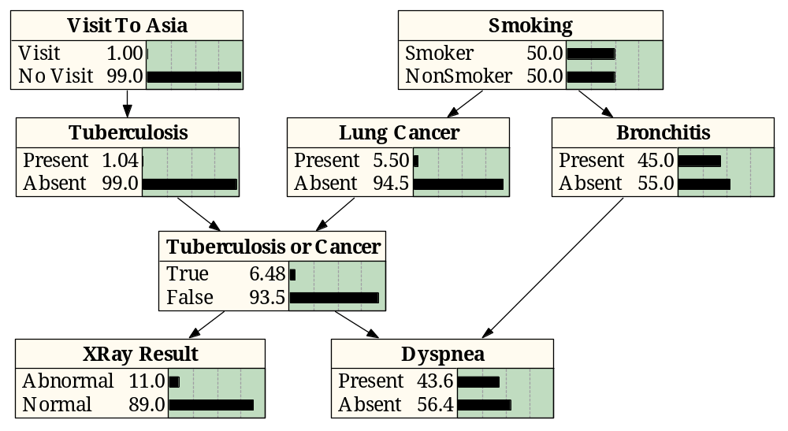
Example from Medical Diagnostics
Propagation algorithm processes relationship information to provide an unconditional or marginal probability distribution for each node
The unconditional or marginal probability distribution is frequently called the belief function of that node

Slide 8
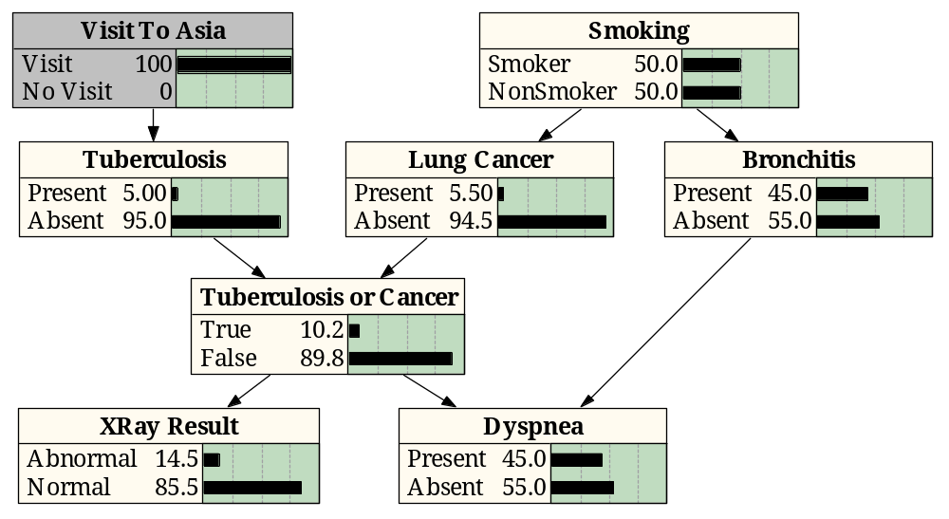
Example from Medical Diagnostics
As a finding is entered, the propagation algorithm updates the beliefs attached to each relevant node in the network
Interviewing the patient produces the information that “Visit to Asia” is “Visit”
This finding propagates through the network and the belief functions of several nodes are updated

Slide 9
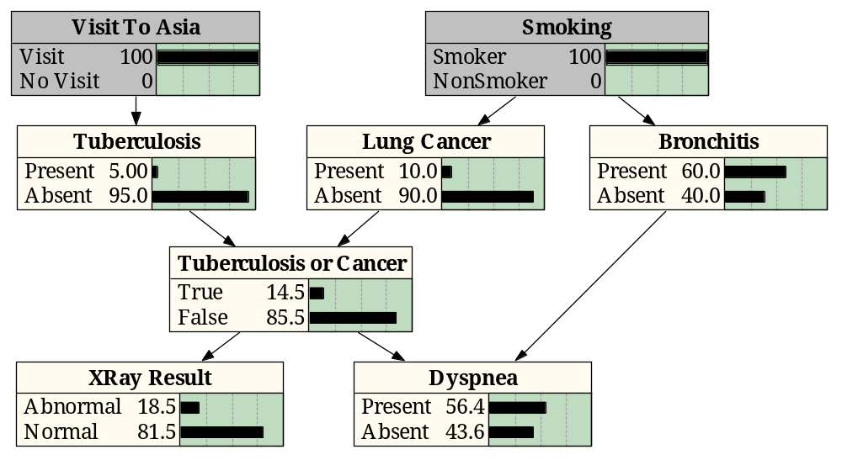
Example from Medical Diagnostics
Further interviewing of the patient produces the finding “Smoking” is “Smoker”
This information propagates through the network

Slide 10
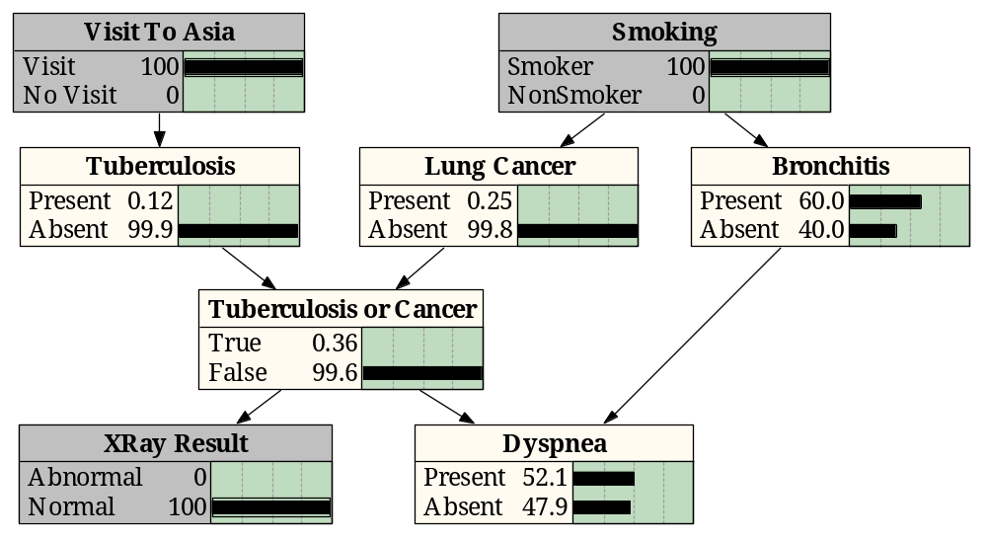
Example from Medical Diagnostics
Finished with interviewing the patient, the physician begins the examination
The physician now moves to specific diagnostic tests such as an X-Ray, which results in a “Normal” finding which propagates through the network
Note that the information from this finding propagates backward and forward through the arcs

Slide 11
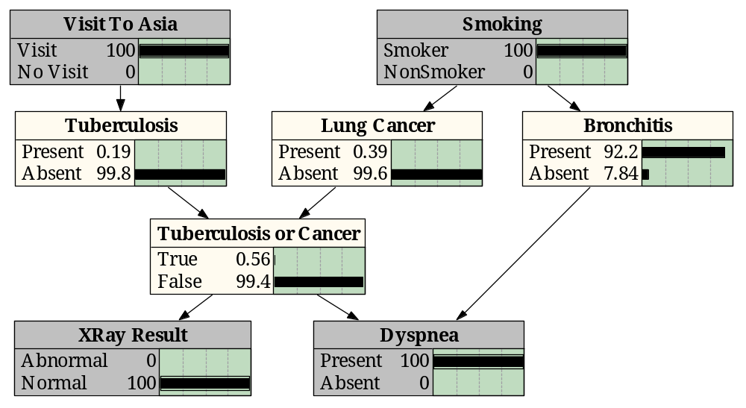
Example from Medical Diagnostics
The physician also determines that the patient is having difficulty breathing, the finding “Present” is entered for “Dyspnea” and is propagated through the network
The doctor might now conclude that the patient has bronchitis and does not have tuberculosis or lung cancer

Slide 12
Applications
Industrial
  Processor Fault Diagnosis - by Intel
  Auxiliary Turbine Diagnosis - GEMS by GE
  Diagnosis of space shuttle propulsion systems - VISTA by NASA/Rockwell
  Situation assessment for nuclear power plant - NRC
Military
  Automatic Target Recognition - MITRE
  Autonomous control of unmanned underwater vehicle - Lockheed Martin
  Assessment of Intent
Medical Diagnosis
  Internal Medicine
  Pathology diagnosis - Intellipath by Chapman & Hall
  Breast Cancer Manager with Intellipath
Commercial
  Financial Market Analysis
  Information Retrieval
  Software troubleshooting and advice - Windows 95 & Office 97
  Pregnancy and Child Care - Microsoft
  Software debugging - American Airlines’ SABRE online reservation system

Slide 13
Definition of a Bayesian Network
Factored joint probability distribution as a directed graph:
  structure for representing knowledge about uncertain variables
  computational architecture for computing the impact of evidence on beliefs
Knowledge structure:
  variables are depicted as nodes
  arcs represent probabilistic dependence between variables
  conditional probabilities encode the strength of the dependencies
Computational architecture:
  computes posterior probabilities given evidence about selected nodes
  exploits probabilistic independence for efficient computation

Slide 14
Sample Factored Joint Distribution
X₁
X₂
X₃
X₅
X₄
X₆
p(x₁, x₂, x₃, x₄, x₅, x₆) = p(x₆ | x₅) p(x₅ | x₃, x₂) p(x₄ | x₂, x₁) p(x₃ | x₁) p(x₂ | x₁) p(x₁)

Slide 15
Bayes Rule
A₂
A₃
A₄
A₁
p(A,
B)
p(B
|
A)p(A)
p(A
|
B)
=
=
p(B)
p(B)
E
A₆
A₅
p(E
|
A
)p(A
)
p(E
|
A
)p(A
)
p(A
|
E)
=
i
i
=
i
i
i
p(E)
∑
p(E
|
A
)p(A
)
i
i
i
Based on definition of conditional probability
p(A_{i}|E) is posterior probability given evidence E
p(A_{i}) is the prior probability
P(E|A_{i}) is the likelihood of the evidence given A_{i}
p(E) is the preposterior probability of the evidence

Slide 16
Arc Reversal - Bayes Rule
X₁
X₂
X₁
X₂
X₃
X₃
p(x₁, x₂, x₃) = p(x₃ | x₁) p(x₂ | x₁) p(x₁)
p(x₁, x₂, x₃) = p(x₃ | x₂, x₁) p(x₂) p( x₁)
is equivalent to
is equivalent to
X₁
X₂
X₁
X₂
X₃
X₃
p(x₁, x₂, x₃) = p(x₃ | x₁) p(x₂ , x₁)
= p(x₃ | x₁) p(x₁ | x₂) p( x₂)
p(x₁, x₂, x₃) = p(x₃, x₂ | x₁) p( x₁)
= p(x₂ | x₃, x₁) p(x₃ | x₁) p( x₁)

Slide 17
Inference Using Bayes Theorem
Tuber-
culosis
Lung
Cancer
Bronchitis
Lung
Cancer
Bronchitis
Tuberculosis
or Cancer
Tuberculosis
or Cancer
Dyspnea
Dyspnea
Lung
Cancer
Lung
Cancer
Lung
Cancer
Tuberculosis
or Cancer
Dyspnea
Dyspnea
Dyspnea
The general probabilistic inference problem is to find the probability of an event given a set of evidence
This can be done in Bayesian nets with sequential applications of Bayes Theorem

Slide 18
Why Not this Straightforward Approach?
Entire network must be considered to determine next node to remove
Impact of evidence available only for single node, impact on eliminated nodes is unavailable
Spurious dependencies between variables normally perceived to be independent are created and calculated
Algorithm is inherently sequential, unsupervised parallelism appears to hold most promise for building viable models of human reasoning
In 1986 Judea Pearl published an innovative algorithm for performing inference in Bayesian nets that overcomes these difficulties - TOMMORROW!!!!

Slide 19
Overview
Day 1
  Motivating Examples
  Basic Constructs and Operations
Day 2
  Propagation Algorithms
  Example Application
Day 3
  Learning
  Continuous Variables
  Software

Slide 20
Introduction to Bayesian Networks
A Tutorial for the 66th MORS Symposium
23 - 25 June 1998
Naval Postgraduate School
Monterey, California
Dennis M. Buede
Joseph A. Tatman
Terry A. Bresnick

Slide 21
Overview
Day 1
  Motivating Examples
  Basic Constructs and Operations
Day 2
  Propagation Algorithms
  Example Application
Day 3
  Learning
  Continuous Variables
  Software

Slide 22
Overview of Bayesian Network Algorithms
Singly vs. multiply connected graphs
Pearl’s algorithm
Categorization of other algorithms
  Exact
  Simulation

Slide 23
Propagation Algorithm Objective
Data
Data
The algorithm’s purpose is “… fusing and propagating the impact of new evidence and beliefs through Bayesian networks so that each proposition eventually will be assigned a certainty measure consistent with the axioms of probability theory.” (Pearl, 1988, p 143)

Slide 24
Singly Connected Networks
(or Polytrees)
Definition : A directed acyclic graph (DAG) in which only one semipath (sequence of connected nodes ignoring direction of the arcs) exists between any two nodes.
Polytree
structure
satisfies
definition
Multiple parents
and/or
multiple children
Do not
satisfy
definition

Slide 25
Notation
X = a random variable (a vector of dimension m); x = a possible value of X
e = evidence (or data), a vector of dimension m
M_{y|x} = p(y|x), the likelihood matrix or conditional probability distribution
y
p(y₁|x₁) p(y₂|x₁) . . . p(y_{n}|x₁)
p(y₁|x₂) p(y₂|x₂) . . . p(y_{n}|x₂)
. . . . . . . . .
p(y₁|x_{m}) p(y₂|x_{m}) . . . p(y_{n}|x_{m})
=
x
Bel (x) = p(x|e), the posterior (a vector of dimension m)
f(x) g(x) = the term by term product (congruent multiplication) of two
vectors, each of dimension m
f(x)  g(x) = the inner (or dot) product of two vectors, or the matrix
multiplication of a vector and a matrix
= a normalizing constant, used to normalize a vector so that its elements sum to 1.0

Slide 26
Bi-Directional Propagation in a Chain
e⁺
Each node transmits a pi message to its
children and a lambda message to its parents.
Bel(Y) = p(y|e⁺, e⁻) = α π(y)^{T}  λ(y)
where
π(y) = p(y|e⁺), prior evidence; a row vector
λ(y) = p(e⁻|y), diagnostic or likelihood evidence;
a column vector
π(y) = Σ_{x} p(y|x, e⁺)  p(x| e⁺) = Σ_{x} p(y|x)  π(x)
= π(x)  M_{y|x}
λ(y) = Σ_{z} p(e⁻|y, z)  p(z| y) = Σ_{z} p(e⁻|z)  p(z| y)
= Σ_{z} λ(z)  p(z| y) = M_{z|y}  λ(z)
(e⁺)
X
(y)
(x)
Y
(z)
(y)
Z
(e⁻)
e⁻

Slide 27
An Example: Simple Chain
p(Paris) = 0.9
p(Med.) = 0.1
M _{TO|SM} =
M _{AA|TO} =
Paris
Med.
Strategic
Mission
Ch
Di
[
]
.8 .2
.1 .9
Pa
Me
Chalons
Dijon
Tactical
Objective
No
Ce
So
[
]
.5 .4 .1
.1 .3 .6
Ch
Di
North
Central
South
Avenue of
Approach

Slide 28
Sample Chain - Setup
(1) Set all lambdas to be a vector of 1’s; Bel(SM) = α λ(SM)  π(SM)
π(SM) Bel(SM) λ(SM)
Paris 0.9 0.9 1.0
Med. 0.1 0.1 1.0
(2) π(TO) = π(SM) M_{TO|SM}; Bel(TO) = α λ(TO)  π(TO)
π(TO) Bel(TO) λ(TO)
Chalons 0.73 0.73 1.0
Dijon 0.27 0.27 1.0
(3) π(AA) = π(TO) M_{AA|TO}; Bel(AA) = α λ(AA)  π(AA)
π(AA) Bel(AA) λ(AA)
North 0.39 0.40 1.0
Central 0.35 0.36 1.0
South 0.24 0.24 1.0
Strategic
Mission
Tactical
Objective
Avenue of
Approach
[
]
[
]
.8 .2
.1 .9
.5 .4 .1
.1 .3 .6
M_{TO|SM} =
M_{AA|TO} =

Slide 29
Sample Chain - 1st Propagation
t
=
0
t = 1
π(SM) = π(IR)
π(SM) Bel(SM) λ(SM)
Paris 0.8 0.8 1.0
Med. 0.2 0.2 1.0
π(TO) Bel(TO) λ(TO)
Chalons 0.73 0.73 1.0
Dijon 0.27 0.27 1.0
π(AA) Bel(AA) λ(AA)
North 0.39 0.3 0.5
Central 0.35 0.5 1.0
South 0.24 0.2 0.6
t = 1
λ(AA) = λ(TR)
π
(lR)
=
[
.8 .2
]
Intel.
Rpt.
Strategic
Mission
Tactical
Objective
Avenue of
Approach
Troop
Rpt.
t
=
0
λ
(
TR
)
=
[
.
5
1 .6
]
T

Slide 30
Sample Chain - 2nd Propagation
t
=
0
π(SM) Bel(SM) λ(SM)
Paris 0.8 0.8 1.0
Med. 0.2 0.2 1.0
t = 2
π(TO) = π(SM) M_{TO|SM}
π(TO) Bel(TO) λ(TO)
Chalons 0.66 0.66 0.71
Dijon 0.34 0.34 0.71
t = 2
λ(TO) = M_{AA|TO} λ(SM)
π(AA) Bel(AA) λ(AA)
North 0.39 0.3 0.5
Central 0.35 0.5 1.0
South 0.24 0.2 0.6
π
(lR)
=
[
.8 .2
]
Intel.
Rpt.
Strategic
Mission
Tactical
Objective
Avenue of
Approach
Troop
Rpt.
t
=
0
λ
(
TR
)
=
[
.
5
1 .6
]
T

Slide 31
Sample Chain - 3rd Propagation
π(SM) Bel(SM) λ(SM)
Paris 0.8 0.8 0.71
Med. 0.2 0.2 0.71
t = 3
λ(SM) = M_{TO|SM}λ(TO)
π(TO) Bel(TO) λ(TO)
Chalons 0.66 0.66 0.71
Dijon 0.34 0.34 0.71
t = 3
π(AA) = π(TO) M_{AA|TO}
π(AA) Bel(AA) λ(AA)
North 0.36 0.25 0.5
Central 0.37 0.52 1.0
South 0.27 0.23 0.6
Intel.
Rpt.
Strategic
Mission
Tactical
Objective
Avenue of
Approach
Troop
Rpt.

Slide 32
Internal Structure of a Single Node Processor
Processor for Node X
Message to
Parent U
Message from
Parent U
λ_{X}(U)
π _{X}(U)
M_{X|U}  λ
π  M_{X|U}
λ(X)
π(X)
Π_{k} λ_{k}(X)
BEL = α π  λ
...
α BEL(X)
λ₁(X)
...
α BEL(X)
λ_{N}(X)
λ₁(X)
λ_{N}(X)
π₁(X)
π_{N}(X)
Message from
Children of X
Message to
Children of X

Slide 33
Propagation
Example
“The impact of each new piece of evidence is
viewed as a perturbation that propagates through
the network via message-passing between
neighboring variables . . .” (Pearl, 1988, p 143`
Data
Data
The example above requires five time periods to reach equilibrium after the introduction of data (Pearl, 1988, p 174)

Slide 34
Categorization of Other Algorithms
Exact algorithms
  on original directed graph (only singly connected, e.g., Pearl)
  on related undirected graph
    Lauritzen & Spiegelhalter
    Jensen
    Symbolic Probabilistic Inference
  on a different but related directed graph
  using conditioning
  using node reductions
Simulation algorithms
  Backward sampling
    Stochastic simulation
  Forward sampling
    Logic sampling
    Likelihood weighting
    (With and without importance sampling)
    (With and without Markov blanket scoring)

Slide 35
Decision Making in Nuclear Power Plant Operations
Monitor
Environment
Situation Assessment (SA)
Decision Making
Start
Assessment
?
1) Monitor the environment
2) Determine the need for situation
assessment
3) Propagate event cues
4) Project Events
5) Assess Situation
6) Make Decision
Project
Events
Propagate
Evidence
Situation Awareness
Updated Situation
Belief Distribution
Assess Situation
Action Required
?
Choose Action
If Situation = S_{i}
Then Procedure = P_{i}
“Decision making in nuclear power plant operations is characterized by:
  Time pressure
  Dynamically evolving scenarios
  High expertise levels on the part of the operators

Slide 36
Model of Situation Assessment and
Human Decision Making
Emergency
Situations
Steam Generator
Tube Rupture
Loss of Coolant
Accident
Loss of Secondary
Coolant
Other
Events
Steam Line
Radiation
Pressurizer
Pressure
Steam Gen-
erator Level
Sensor
Outputs
Steam Line
Radiation Alarm
Pressurizer
Indicator
Steam Generator
Indicator
The Bayesian net situation assessment model provides:
  Knowledge of the structural relationship among situations, events, and event cues
  Means of integrating the situations and events to form a holistic view of their meaning
  Mechanism for projecting future events

Slide 37
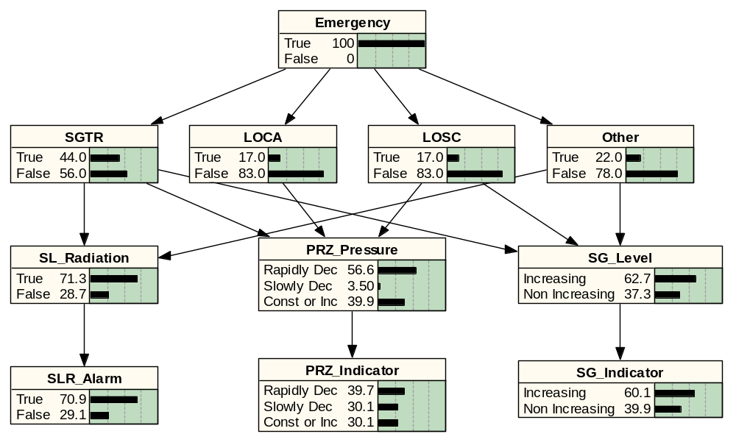
Situation Assessment Bayesian Net
Initial Conditions Given Emergency

Slide 38
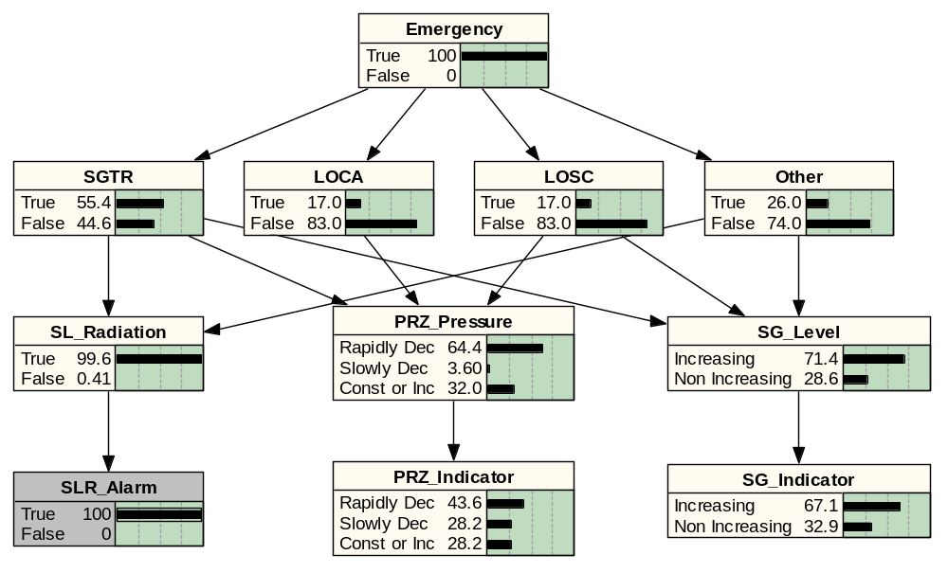
Situation Assessment Bayesian Net
Steam Line Radiation Alarm Goes High

Slide 39
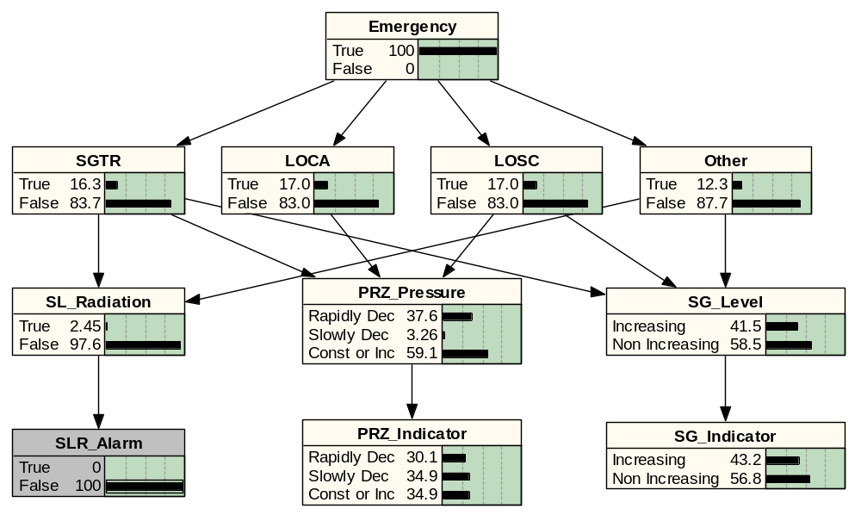
Situation Assessment Bayesian Net
Steam Line Radiation Alarm Goes Low

Slide 40
Simulation of SGTR Scenario
Event Timeline

Slide 41
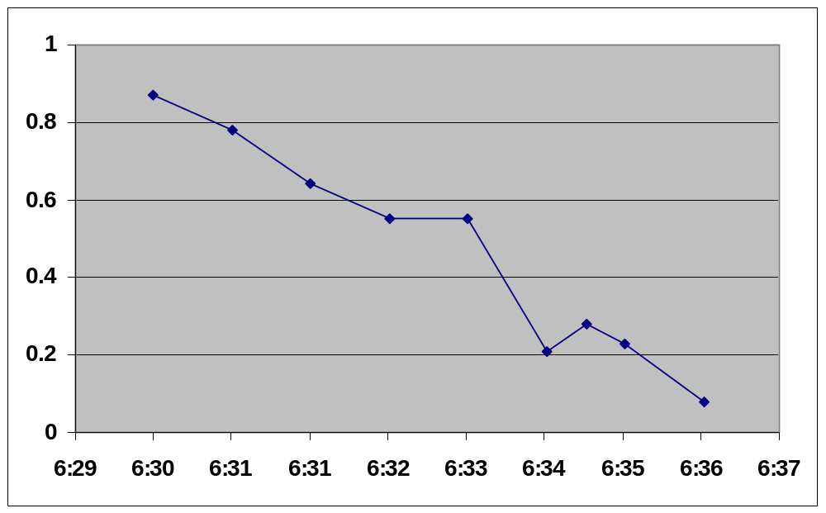
Simulation of SGTR Scenario
Convergence of Situation Disparity
Situation Disparity is defined as follows:
  SD(t) = | Bel (S(t)) - Bel(S’(t)) |
  S represents the actual situation
  S’ represents the perceived situation

Slide 42
Overview
Day 1
  Motivating Examples
  Basic Constructs and Operations
Day 2
  Propagation Algorithms
  Example Application
Day 3
  Learning
  Continuous Variables
  Software

Slide 43
Introduction to Bayesian Networks
A Tutorial for the 66th MORS Symposium
23 - 25 June 1998
Naval Postgraduate School
Monterey, California
Dennis M. Buede, dbuede@gmu.edu
Joseph A. Tatman, jatatman@aol.com
Terry A. Bresnick, bresnick@ix.netcom.com
http://www.gmu.edu -
Depts (Info Tech & Eng) - Sys. Eng. - Buede

Slide 44
Overview
Day 1
  Motivating Examples
  Basic Constructs and Operations
Day 2
  Propagation Algorithms
  Example Application
Day 3
  Learning
  Continuous Variables
  Software

Slide 45
Building BN Structures
Problem
Domain
Probability
Elicitor
Bayesian
Network
Expert
Knowledge
Problem
Domain
Learning
Algorithm
Bayesian
Network
Training
Data
Problem
Domain
Learning
Algorithm
Bayesian
Network
Expert
Knowledge
Training
Data

Slide 46
Learning Probabilities from Data
Exploit conjugate distributions
  Prior and posterior distributions in same family
  Given a pre-defined functional form of the likelihood
For probability distributions of a variable defined between 0 and 1, and associated with a discrete sample space for the likelihood
  Beta distribution for 2 likelihood states (e.g., head on a coin toss)
  Multivariate Dirichlet distribution for 3+ states in likelihood space

Slide 47
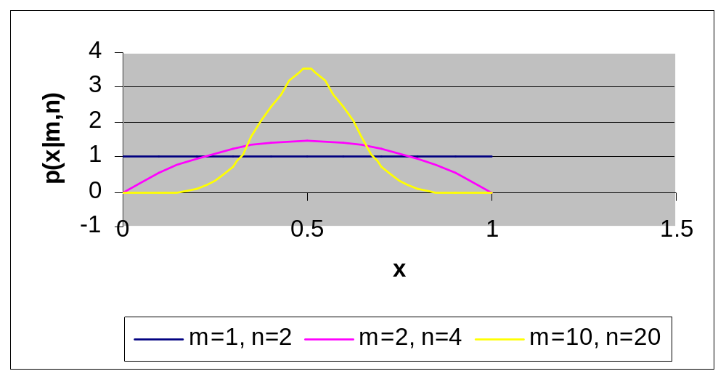
Beta Distribution
Γ
(n)
p
(x
|
m,
n)
=
x
m
−
1
(1
−
x)
n
−
m
−
1
Beta
Γ
(m)
Γ
(n
−
m)
m
mean
=
n
m(1
−
m/n)
variance
=
n(n
+
1)

Slide 48
Multivariate Dirichlet Distribution
N
Γ
(
∑
m
)
i
p
(x
|
m
,
m
,...,
m
)
=
i
=
1
x
m
1
−
1
x
m
2
-
1
...x
m
N
−
1
Dirichlet
1
2
N
Γ
(m
)
Γ
(m
)...
Γ
(m
)
1
2
N
m
mean
of
the
i
th
state
=
i
N
∑
m
i
i
=
1
N
m
(1
−
m
/
∑
m
)
i
i
i
variance
of
the
i
th
state
=
i
=
1
N
N
∑
m
(
∑
m
+
1)
i
i
i
=
1
i
=
1

Slide 49
Updating with Dirichlet
Choose prior with m₁ = m₂ = … = m_{N} = 1
  Assumes no knowledge
  Assumes all states equally likely: .33, .33, .33
  Data changes posterior most quickly
  Setting m_{i} = 101 for all i would slow effect of data down
Compute number of records in database in each state
For 3 state case:
  99 records in first state, 49 in second, 99 in third
  Posterior values of m’s: 100, 50, 100
  Posterior probabilities equal means: .4, .2, .4
  For m_{i} equal 101, posterior probabilities would be: .36, .27, .36

Slide 50
Learning BN Structure from Data
Entropy Methods
  Earliest method
  Formulated for trees and polytrees
Conditional Independence (CI)
  Define conditional independencies for each node (Markov boundaries)
  Infer dependencies within Markov boundary
Score Metrics
  Most implemented method
  Define a quality metric to maximize
  Use greedy search to determine the next best arc to add
  Stop when metric does not increase by adding an arc
Simulated Annealing & Genetic Algorithms
  Advancements over greedy search for score metrics

Slide 51
Sample Score Metrics
Bayesian score: p(network structure | database)
Information criterion: log p(database | network structure and parameter set)
  Favors complete networks
  Commonly add a penalty term on the number of arcs
Minimum description length: equivalent to the information criterion with a penalty function
  Derived using coding theory

Slide 52
Features for Adding Knowledge to Learning Structure
Define Total Order of Nodes
Define Partial Order of Nodes by Pairs
Define “Cause & Effect” Relations

Slide 53
Demonstration of Bayesian Network Power Constructor
Generate a random sample of cases using the original “true” network
  1000 cases
  10,000 cases
Use sample cases to learn structure (arc locations and directions) with a CI algorithm in Bayesian Power Constructor
Use same sample cases to learn probabilities for learned structure with priors set to uniform distributions
Compare “learned” network to “true” network

Slide 54
Enemy Intent
Intelligence
Reports
Enemy’s
Intelligence
on
Friendly
Forces
Strategic
Mission
Weather
Weather
Forecast
&
Feasibility
Analysis
Trafficability
of S. AA
Tactical
Objective
Trafficability
of C. AA
Troops @
NAI 1
Avenue of
Approach
Trafficability
of N. AA
Observations
on Troop
Movements
Troops @
NAI 2
Deception
Plan
AA - Avenue of Approach
NAI - Named Area of Interest

Slide 55
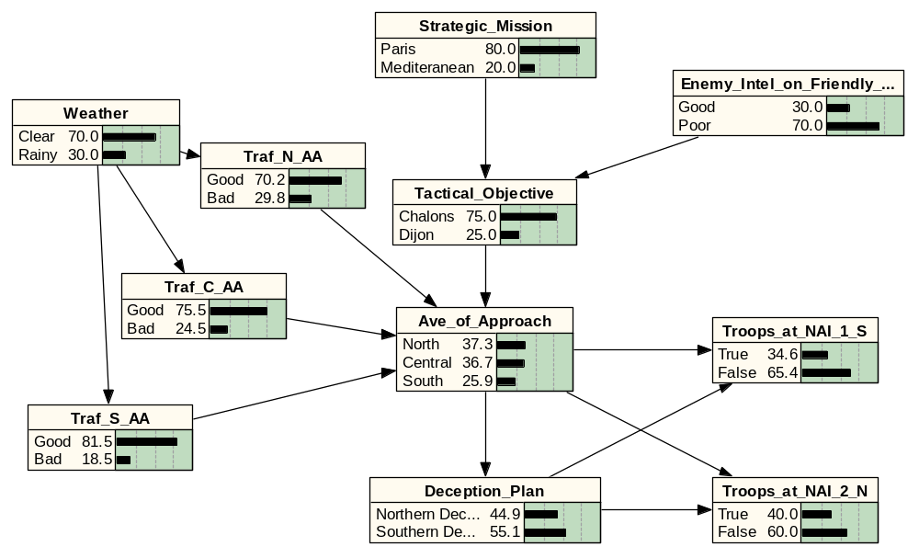
Original Network

Slide 56
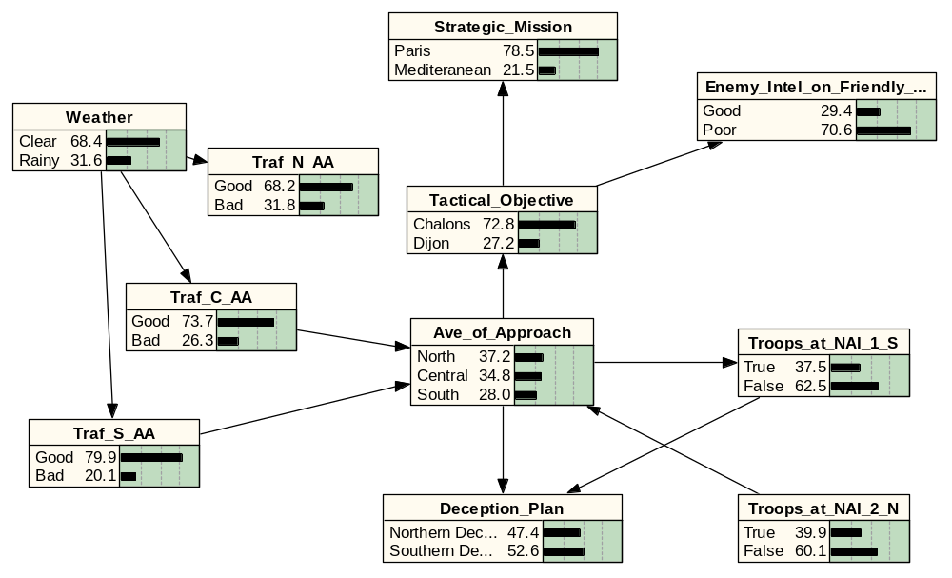
Learned Network with 1000 Cases
Missing Arcs: 2
Added Arcs: 0
Arcs Misdirected: 5
Arcs Unspecified: 3
Missing Arcs: 2
Added Arcs: 0
Arcs Misdirected: 5
Arcs Unspecified: 3

Slide 57
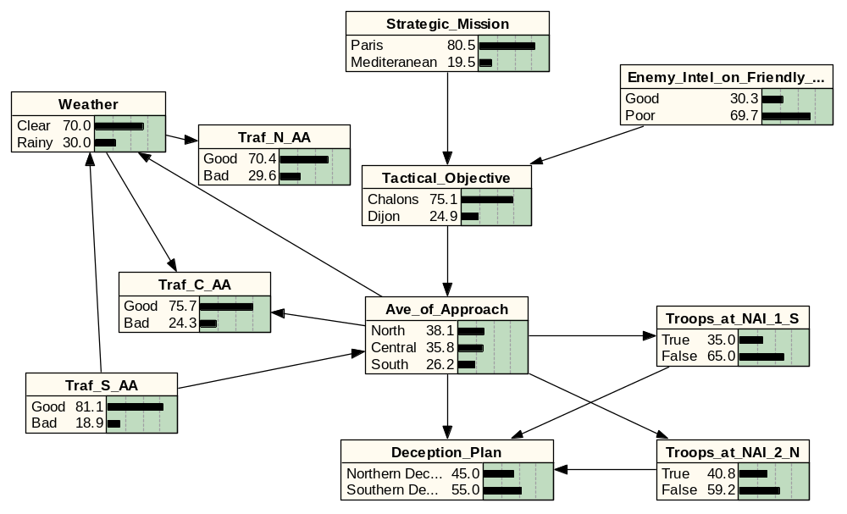
Learned Network with 10,000 Cases
Missing Arcs: 1
Added Arcs: 1
Arcs Misdirected: 4

Slide 58
Comparison of Learned Networks with Truth
p(AoA)
Truth
1 K
10 K
Prior
.37, .37, .26
.37, .35, .28
.38, .36, .26
“Clear”
.41, .37, .22
.38, .36, .26
.41, .36, .23
“Rainy”
.30, .36, .34
.35, .32, .33
.30, .36, .34
“NAI 1 True”
.15, .13, .71
.17, .12, .71
.16, .12, .71
“Rain, NAI 1
.10, .11, .79
.15, .10, .75
.11, .11, .78
True”
“Rain, NAI 1 &
.56, .02, .43
.59, .05, .36
.56, .03, .40
2 True”

Slide 59
Summary of Comparison
Reasonable accuracy can be obtained with a relatively small sample
  Prior probabilities (before data) look better than posterior probabilities (after data) for small samples
More data improves results, but may not guarantee learning the same network
Using partial order expertise can improve the structure of the learned network
Comparison did not have any nodes with low probability outcomes
  Learning algorithms requires 200-400 samples per outcome
  In some cases, even 10,000 data points will not be enough

Slide 60
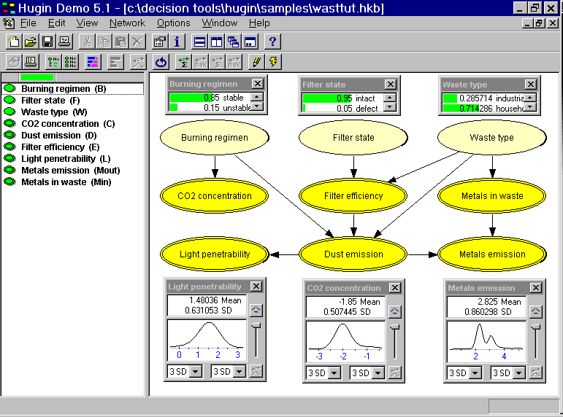
Continuous Variables Example
Data from three sensors can be fused to gain information on relevant variables

Slide 61
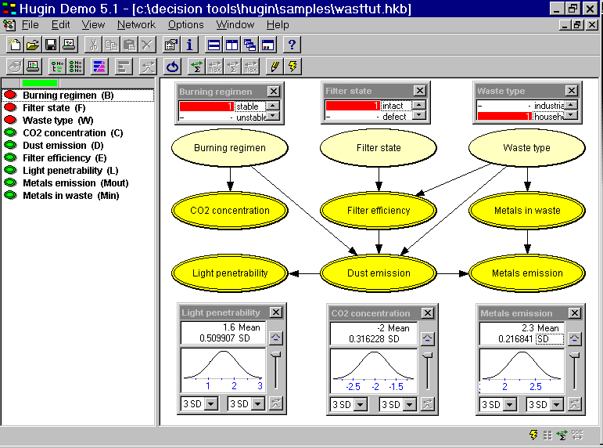
Continuous Variables Example
Entering values for the three discrete random variables shifts the sensor mean values

Slide 62
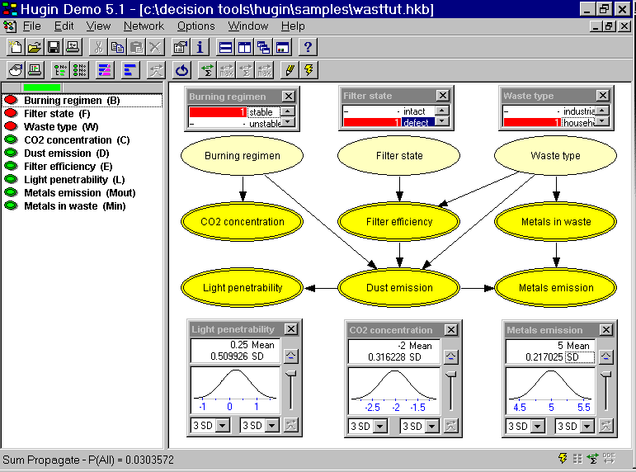
Continuous Variables Example
A defective filter has a strong impact on the light penetrability and metal emissions sensors

Slide 63
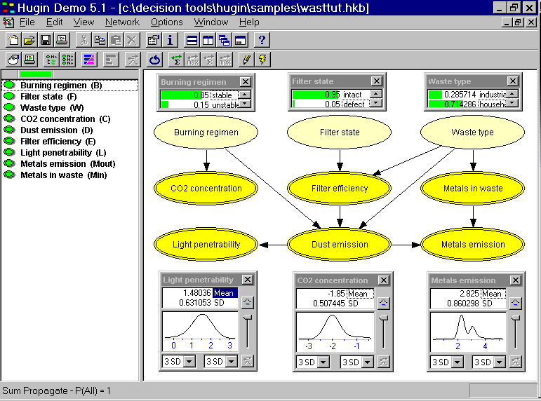
Continuous Variables Example
What can we learn about the three state variables given sensor outputs?

Slide 64
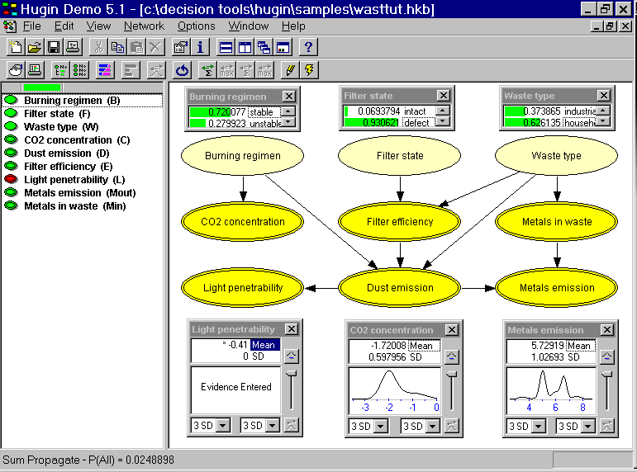
Continuous Variables Example
A light penetrability reading that is 3 sigma low is a strong indicator of a defective filter

Slide 65
Software
Many software packages available
  See Russell Almond’s Home Page
Netica
  www.norsys.com
  Very easy to use
  Implements learning of probabilities
  Will soon implement learning of network structure
Hugin
  www.hugin.dk
  Good user interface
  Implements continuous variables

Slide 66
Basic References
Pearl, J. (1988). Probabilistic Reasoning in Intelligent Systems. San Mateo, CA: Morgan Kauffman.
Oliver, R.M. and Smith, J.Q. (eds.) (1990). Influence Diagrams, Belief Nets, and Decision Analysis, Chichester, Wiley.
Neapolitan, R.E. (1990). Probabilistic Reasoning in Expert Systems, New York: Wiley.
Schum, D.A. (1994). The Evidential Foundations of Probabilistic Reasoning, New York: Wiley.
Jensen, F.V. (1996). An Introduction to Bayesian Networks, New York: Springer.

Slide 67
Algorithm References
Chang, K.C. and Fung, R. (1995). Symbolic Probabilistic Inference with Both Discrete and Continuous Variables, IEEE SMC, 25(6), 910-916.
Cooper, G.F. (1990) The computational complexity of probabilistic inference using Bayesian belief networks. Artificial Intelligence, 42, 393-405,
Jensen, F.V, Lauritzen, S.L., and Olesen, K.G. (1990). Bayesian Updating in Causal Probabilistic Networks by Local Computations. Computational Statistics Quarterly, 269-282.
Lauritzen, S.L. and Spiegelhalter, D.J. (1988). Local computations with probabilities on graphical structures and their application to expert systems. J. Royal Statistical Society B, 50(2), 157-224.
Pearl, J. (1988). Probabilistic Reasoning in Intelligent Systems. San Mateo, CA: Morgan Kauffman.
Shachter, R. (1988). Probabilistic Inference and Influence Diagrams. Operations Research, 36(July-August), 589-605.
Suermondt, H.J. and Cooper, G.F. (1990). Probabilistic inference in multiply connected belief networks using loop cutsets. International Journal of Approximate Reasoning, 4, 283-306.

Slide 68
Backup

Slide 69
The Propagation Algorithm
As each piece of evidence is introduced, it generates:
  A set of “π” messages that propagate through the network in the direction of the arcs
  A set of “λ” messages that propagate through the network against the direction of the arcs
As each node receives a “π” or “λ” message:
  The node updates its own “π” or “λ” and sends it out onto the network
  The node uses its updated “π” or “λ” to update its BEL function
T
BEL(t)
π(t) λ(t)
U
BEL(t)
π(t) λ(t)
X
BEL(t)
π(t) λ(t)
Y
BEL(t)
π(t) λ(t)
Z
BEL(t)
π(t) λ(t)
M_{u|t}
M_{y|x}
M_{x|u}
M_{z|y}

Slide 70
Key Events in Development of Bayesian Nets
1763 Bayes Theorem presented by Rev Thomas Bayes (posthumously) in the Philosophical Transactions of the Royal Society of London
19xx Decision trees used to represent decision theory problems
19xx Decision analysis originates and uses decision trees to model real world decision problems for computer solution
1976 Influence diagrams presented in SRI technical report for DARPA as technique for improving efficiency of analyzing large decision trees
1980s Several software packages are developed in the academic environment for the direct solution of influence diagrams
1986? Holding of first Uncertainty in Artificial Intelligence Conference motivated by problems in handling uncertainty effectively in rule-based expert systems
1986 “Fusion, Propagation, and Structuring in Belief Networks” by Judea Pearl appears in the journal Artificial Intelligence
1986,1988 Seminal papers on solving decision problems and performing probabilistic inference with influence diagrams by Ross Shachter
1988 Seminal text on belief networks by Judea Pearl, Probabilistic Reasoning in Intelligent Systems: Networks of Plausible Inference
199x Efficient algorithm
199x Bayesian nets used in several industrial applications
199x First commercially available Bayesian net analysis software available

Slide 71
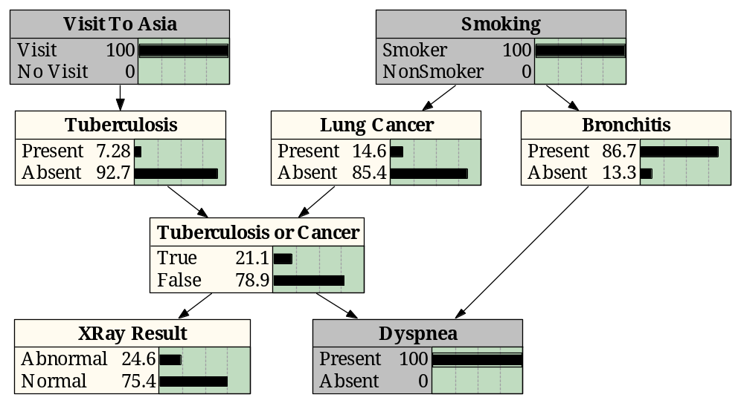
Example from Medical Diagnostics
Finished with interviewing the patient, the physician begins the examination
The physician determines that the patient is having difficulty breathing, the finding “Dyspnea” is “Present” is entered and propagated through the network
Note that the information from this finding propagates backward through the arcs

Slide 72
Example from Medical Diagnostics
The physician now moves to specific diagnostic tests such as an X-Ray, which results in a “Normal” finding which propagates through the network
The doctor might now conclude that the evidence strongly indicates the patient has bronchitis and does not have tuberculosis or lung cancer

Slide 73
Tuberculosis
Lung Cancer
Bronchitis
Tuberculosis
or Cancer
XRay Result
Dyspnea

Slide 74
Inference Using Bayes Theorem
Smoker
Smoker
Smoker
Tuber-
culosis
Lung
Cancer
Tuber-
culosis
Lung
Cancer
Lung
Cancer
Tuberculosis
or Cancer
Tuberculosis
or Cancer
Tuberculosis
or Cancer
Smoker
Smoker
Smoker
Lung
Cancer
Tuberculosis
or Cancer
Tuberculosis
or Cancer
The general probabilistic inference problem is to find the probability of an event given a set of evidence
This can be done in Bayesian nets with sequential applications of Bayes Theorem

Slide 75
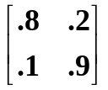
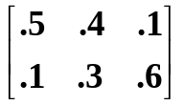
Sample Chain - Setup
(1) Set all lambdas to be a vector of 1’s; Bel(SM) = α λ(SM)  π(SM)
π(SM) Bel(SM) λ(SM)
Paris 0.9 0.9 1.0
Med. 0.1 0.1 1.0
(2) π(TO) = π(SM) M_{TO|SM}; Bel(TO) = α λ(TO)  π(TO)
π(TO) Bel(TO) λ(TO)
Chalons 0.73 0.73 1.0
Dijon 0.27 0.27 1.0
(3) π(AA) = π(TO) M_{AA|TO}; Bel(AA) = α λ(AA)  π(AA)
π(AA) Bel(AA) λ(AA)
North 0.39 0.73 1.0
Central 0.35 0.27 1.0
South 0.24 0.24 1.0
Strategic
Mission
Tactical
Objective
Avenue of
Approach
M_{TO|SM} =
M_{AA|TO} =

